Slide 1
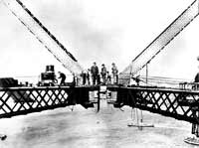
Sydney Harbour Bridge
The engineer didn’t use surds when calculating the needs for building a bridge. They built the bridge from both sides to meet in the middle, but the inaccuracy meant the twos halves didn’t meet.
Notes:
hook

Slide 2
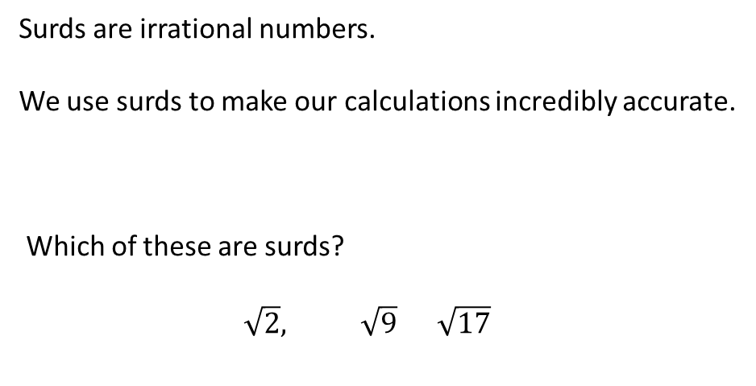
24
7
30
Date
Surds
EQ – What are surds?
Surds are irrational numbers.
We use surds to make our calculations incredibly accurate.
Which of these are surds?
$$\sqrt{2}, \sqrt{9} \sqrt{17}$$
5
Notes:
Lesson objective (EQ)

Slide 3
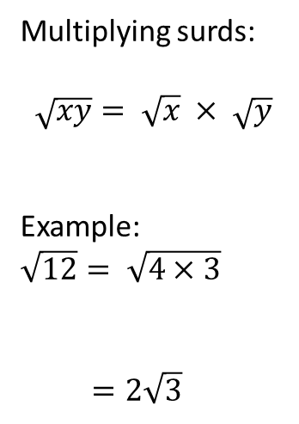
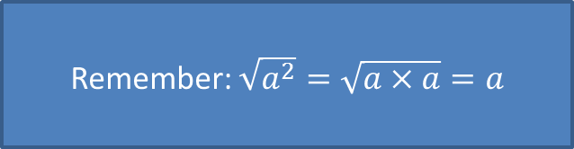
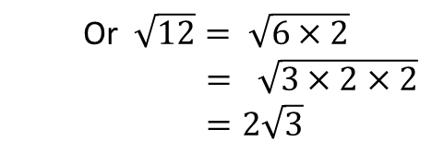
24
7
30
Date
Surds
EQ – What are some surd basics?
Multiplying surds:
$$\sqrt{xy}= \sqrt{x} × \sqrt{y}$$
Example:
$$\sqrt{12}= \sqrt{4×3}$$
$$=2\sqrt{3}$$
Or $\sqrt{12}= \sqrt{6×2}$ $$= \sqrt{3×2×2}$$
$=2\sqrt{3}$
Remember: $\sqrt{a^{2}}=\sqrt{a×a}=a$
5
Notes:
Input

Slide 4
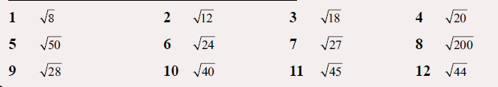
Notes:
Guided practice

Slide 5




Answers
$$2\sqrt{2}$$
$$5\sqrt{2}$$
$$2\sqrt{7}$$
$$2\sqrt{3}$$ $$2\sqrt{6}$$
$$2√5$$
$$3\sqrt{2}$$
$$3\sqrt{3}$$
$$3√5$$
$$2\sqrt{5}$$
$$10\sqrt{2}$$
$$2√11$$
Notes:
Guided practice

Slide 6
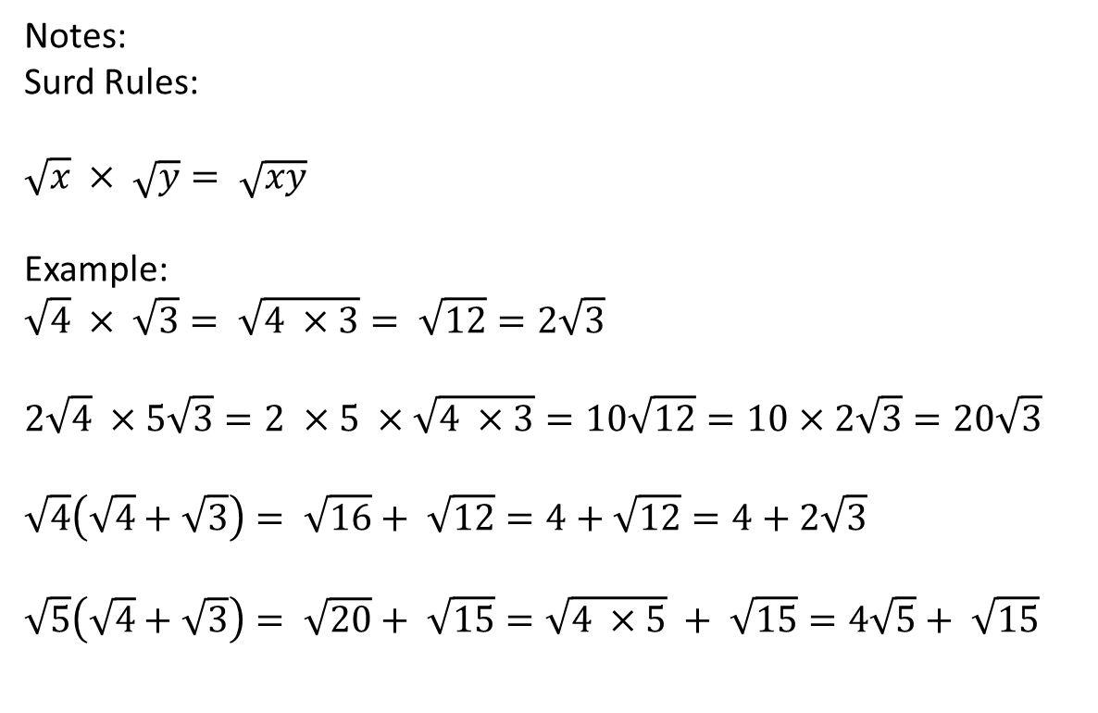
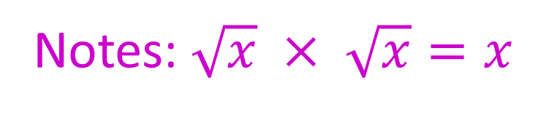
24
7
30
Surds
EQ : What are surds?
Question:
Notes:
Surd Rules:
$$\sqrt{x} × \sqrt{y}= \sqrt{xy}$$
Example:
$$\sqrt{4} × \sqrt{3}= \sqrt{4 ×3}= \sqrt{12}=2\sqrt{3}$$
$$2\sqrt{4} ×5\sqrt{3}=2 ×5 ×\sqrt{4 ×3}=10\sqrt{12}=10×2\sqrt{3}=20\sqrt{3}$$
$$\sqrt{4}\left(\sqrt{4}+\sqrt{3}\right)= \sqrt{16}+ \sqrt{12}=4+\sqrt{12}=4+2\sqrt{3}$$
$\sqrt{5}\left(\sqrt{4}+\sqrt{3}\right)= \sqrt{20}+ \sqrt{15}=\sqrt{4 ×5} + \sqrt{15}=4\sqrt{5}+ \sqrt{15}$
Notes: $\sqrt{x} × \sqrt{x}=x$
Notes:
Independent practice

Slide 7
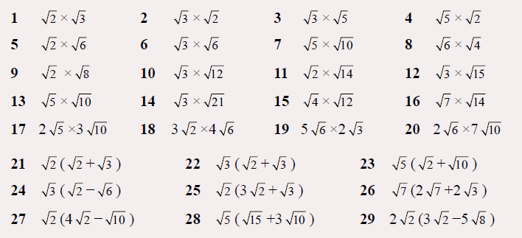

Slide 8




Some Answers
$$\sqrt{6}$$
$$\sqrt{12}$$
$$√16$$
$$6√50$$
$$\sqrt{4}+√6$$
$$\sqrt{6}−√18$$

Slide 9


24
7
30
Surds
EQ : What are surds?
Question:
Notes:
Surd Rules:
$$a\sqrt{x}+b\sqrt{x}=(a+b)\sqrt{x}$$
$$a\sqrt{x}−b\sqrt{x}=(a−b)\sqrt{x}$$
Examples:
10$\sqrt{3}+5\sqrt{3}=15\sqrt{3}$
$$\sqrt{5} −8+7\sqrt{5}=8\sqrt{5 } −8$$
7$\sqrt{3}−5\sqrt{12}=7\sqrt{3} −5\sqrt{3×4}=7\sqrt{3}−5×2\sqrt{3}=7\sqrt{3}−10\sqrt{3}=−3\sqrt{3}$
Treat it like an algebraic expression
10a+5a=15a a is$√3$

Slide 10
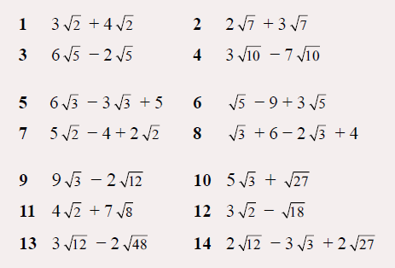

Slide 11






Answers
$$7\sqrt{2}$$
$$4\sqrt{5}$$
$$3\sqrt{3}+5$$
$$7\sqrt{2}−4$$
$$5√3$$
$$18√2$$
$$−2√3$$

